Slide 1





d
Helping you stay prepared
Presented by -- Tanvi Akre - 31031823001 Vidhi Murdeshwar - 31031823008

Slide 2
Flow of this presentation
1
STEP
2
STEP
Sampling Technique and Data
3
4
STEP
Conclusion
STEP
Introduction
Aims and Objectives
Data Analysis
KNN Algorithm
Chi sq test Random Forest Cluster Analysis
Multinomial Logistic Regression
Visualization

Slide 3
Introduction
A vital tool for financial security, ensuring access to medical care without excessive expenses.
Urban areas benefit from better healthcare access and higher insurance awareness, while rural populations face challenges like affordability and limited facilities.
Economic liberalization and IRDAI regulations have boosted private health insurance, but penetration remains uneven
Analyzing claim patterns and insurance utilization to bridge gaps and improve accessibility for diverse populations.

Slide 4
Aim
Inefficiencies in insurance claims
processing arise due to demographic, behavioral, and economic differences between rural and urban policyholders.
The primary aim of this study is to analyze insurance claim patterns and policyholder behaviour in rural and urban areas using statistical and machine learning techniques
PROBLEM STATEMENT

Slide 5
High-risk policyholders
Claim settlement rates
Policyholder satisfaction
Key factors
Provide actionable insights
Switching behavior

Slide 6
Sampling Technique

Slide 7
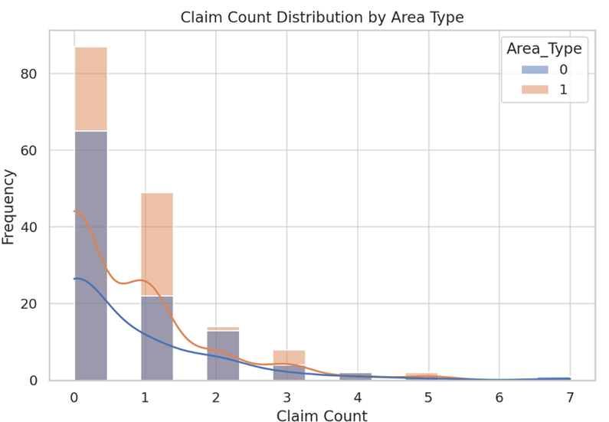
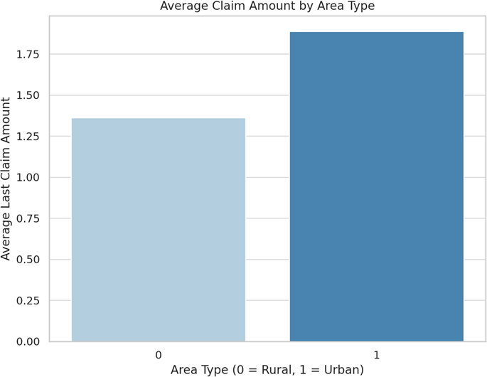
Exploratory Data Analysis (EDA)
Claim count distribution by area type
Average claim amount by area type

Slide 8
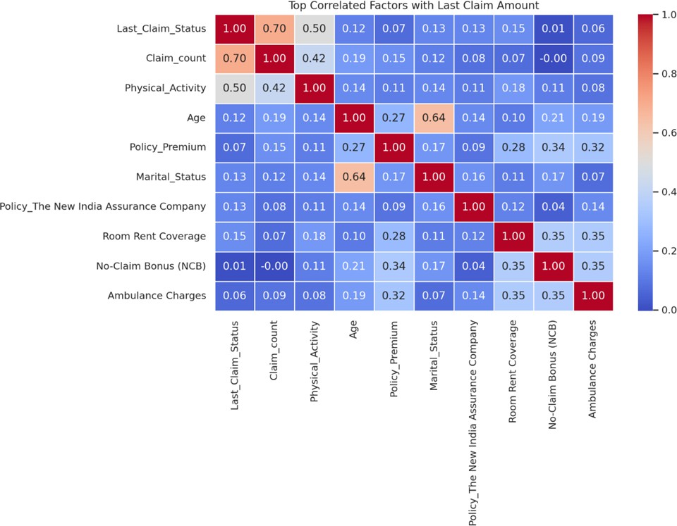
Correlation Heatmap of Factors Affecting Last Claim Amount
Claim_count (0.70): Strongly linked to Last_Claim_Status which implies that past claims predict future risk.
Physical_Activity (0.50): Surprisingly positive implying that it may reflect high-risk activities.
Room Rent Coverage &
Ambulance Charges (~0.35): Moderate correlation : Impacts overall claim amount.
Age & Marital_Status (~0.12-
0.13): Weak correlation: Has minor influence on claims.
No-Claim Bonus (0.01): Minimal
correlation : Has less impact on recent claim trends

Slide 9

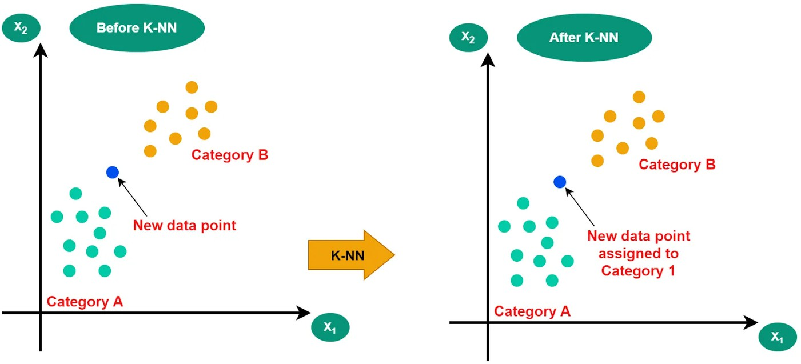
K-NEAREST NEIGHBORS
K-Nearest Neighbours (KNN) is a supervised machine learning algorithm used for classification and regression.
It predicts the output based on the majority class or average value of the 'k' closest data points. The distance between data points is typically measured using Euclidian distance.
KNN is simple, non-parametric, and effective but can be slow with large datasets.

Slide 10
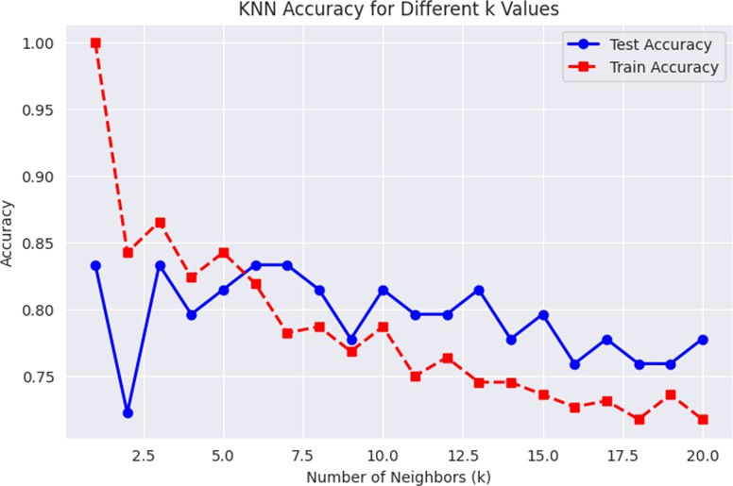
OBJECTIVE 1
To predict whether an individual will or will not make an insurance claim based on their smoking status, alcohol consumption, and physical activity levels.
Since k = 5-7 provides the best generalization, we select k = 5 for the KNN algorithm as the optimal choice.

Slide 11
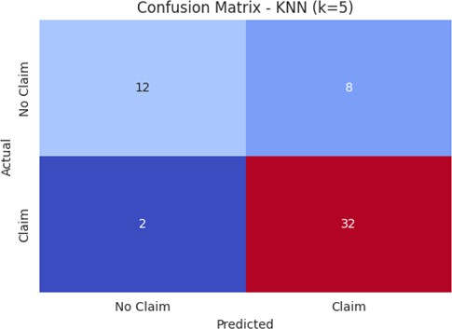
Using K=5
Accuracy= (TN+TP)/(TN+TP+FN+FP)
Accuracy score = 81.48%
Accuracy (81.48%) implies that, the model correctly predicts whether a claim is made in 81.48% of cases.
Stronger prediction performance for "Claim" behavior
These health factors can be useful predictors for underwriting and fraud detection

Slide 12
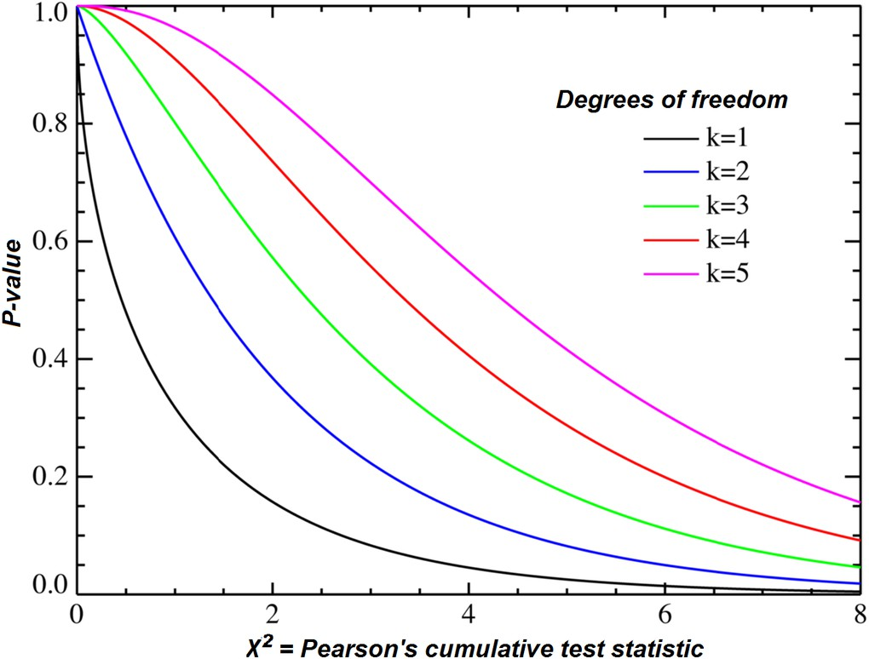
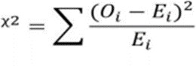
CHI-SQUARE TESTS
The Chi-Square test is a statistical method used to determine if there’s a significant association between categorical variables.
A large difference between observed and expected values suggests a possible relationship between variables.
Commonly used in tests of independence and goodness-of-fit in surveys and experiments.

Slide 13

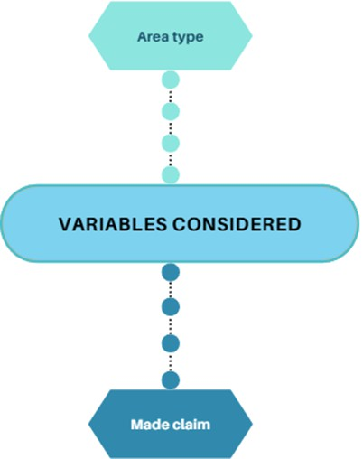
OBJECTIVE 2
To Compare claim behaviours between urban and rural policyholders.
H₀: Area type and Made claim are independent. (There is no significant relationship between them.) H₁: Area type and Made claim are dependent. (There is a significant relationship between them.)

Slide 14
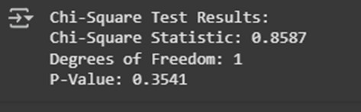
DECISION CRITERIA (For α = 0. 05)
If p value is less than 0.05 then we reject null hypothesis & conclude that there is association between two variables, i.e., they are dependent on each other.
CONCLUSION
P-value = 0.3541 > 0.05 concluding that we fail to reject the null hypothesis.
This means there is no significant association between Area type and Made Claim.

Slide 15
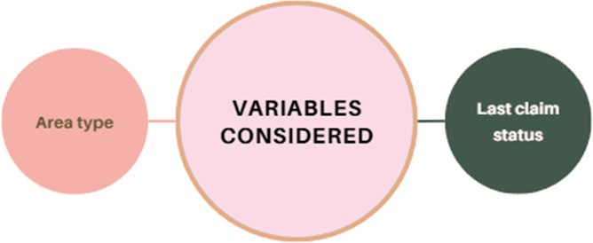
OBJECTIVE 3.
To test the association between claim settlement and area type.
Chi-Square Statistic: 9.15736799105607
P-value: 0.010268400669748498
Degrees of Freedom: 2
Since p-value < 0.05, we reject the null hypothesis (H₀).
Therefore, there is a significant association between Area type and Last claim status. And they are dependent of each other.

Slide 16
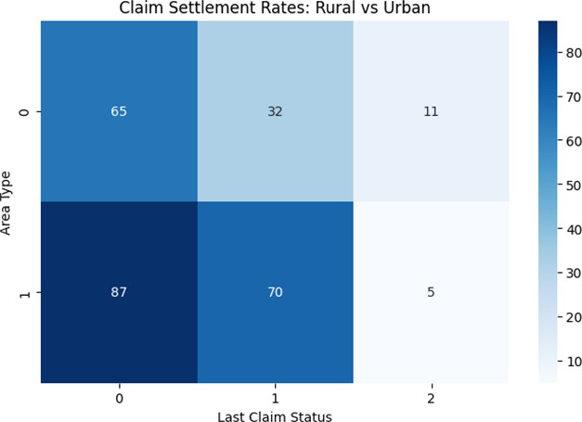
CONCLUSION
Location (Rural vs. Urban) significantly impacts claim settlement rates.
Urban areas (1) have higher claim settlements (87 cases) compared to Rural (65 cases). Pending claims (status = 1) are also higher in Urban areas (70) compared to Rural (32). Rejections (status = 2) are slightly higher in Rural (11) compared to Urban (5).

Slide 17
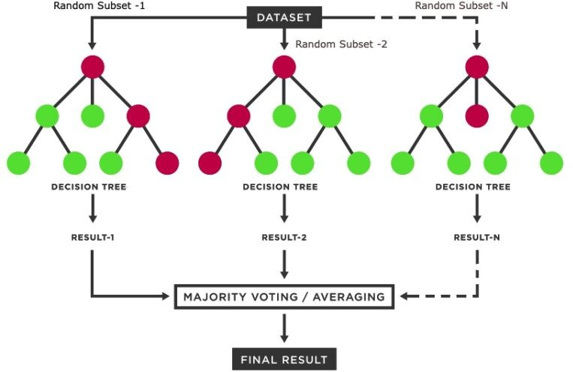
RANDOM FOREST MODEL
An ensemble learning algorithm that builds multiple decision trees during training and combines their results.
Helps improve prediction accuracy and controls overfitting.
Why Use Random Forest?
Handles both classification and regression problems.
Works well with non-linear relationships and high-dimensional data.
Provides feature importance, helping us identify what drives satisfaction.

Slide 18
OBJECTIVE 4
To assess policyholder satisfaction levels and determine key policy features influencing overall satisfaction.

Slide 19

Accuracy=(TN+TP)/(TN+TP+FN+FP)
Accuracy = 81.48%
Actual
→ Predicted
Class 0
Class 1
Class 2
Class 3
0
15
1
0
0
1
1
17
2
0
2
0
2
8
4
3
0
0
0
4
Conclusion:
Top factors: Cashless Treatment, NCB, Critical Illness Coverage
Helps design better policies focused on customer satisfaction

Slide 20
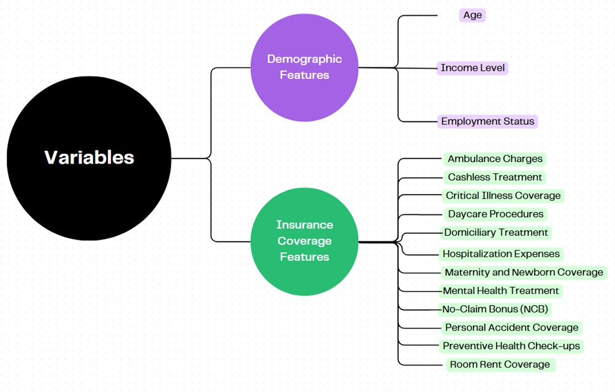
OBJECTIVE 5
CLUSTERING ANALYSIS
To identify distinct policyholder segments using clustering techniques based on claim patterns and demographics.
FEATURE SELECTION

Slide 21
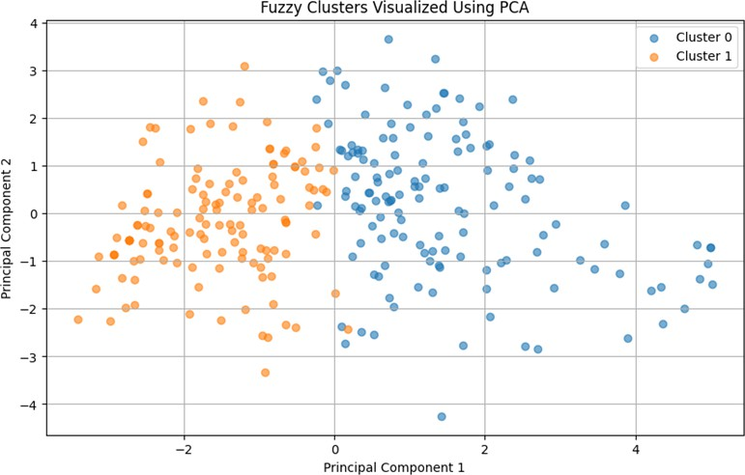
Why Fuzzy C-Means?
Unlike K-Means, which assigns each data point to a single cluster.
FCM allows partial membership, meaning a data point can belong to multiple clusters with varying probabilities.
This flexibility is ideal for overlapping customer segments, providing a more realistic classification.
FCM clustering to segment policyholders based on claim patterns and demographics.

Slide 22
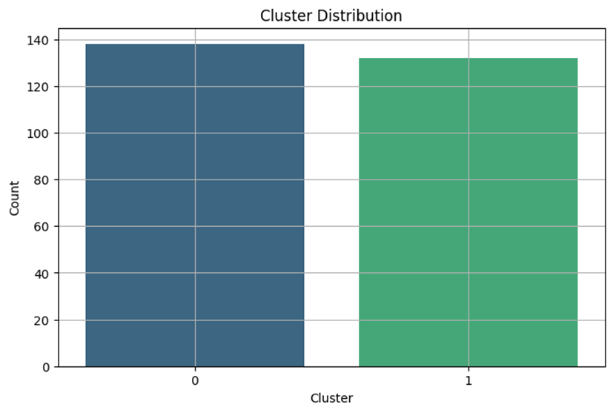
Cluster Distribution Analysis
Nearly equal distribution across both clusters. Indicates a balanced and meaningful segmentation.

Slide 23

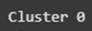
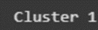

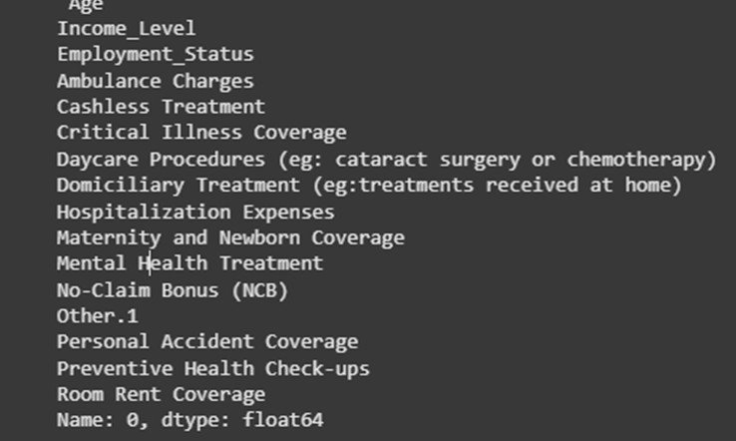
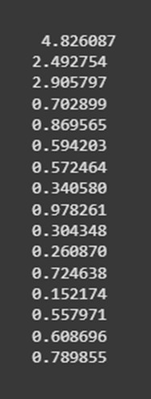
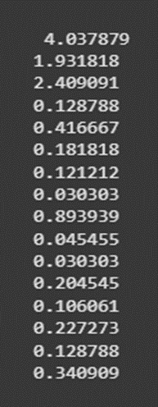
Two well-separated clusters:
Cluster 0: Older, higher income, more benefits used Cluster 1: Younger, less coverage, low utilization

Slide 24
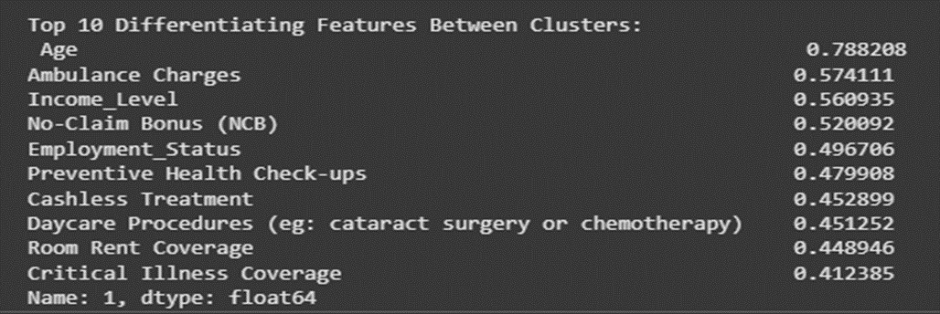
Interpretation:
Marketing & Insurance Strategy
Cluster 0: Can be targeted for premium insurance plans with added benefits.
Cluster 1: Needs affordable, entry-level insurance plans with flexible payment options.
Healthcare Planning
Cluster 0 likely requires more frequent healthcare services.
Cluster 1 may benefit from awareness programs to encourage preventive care.

Slide 25
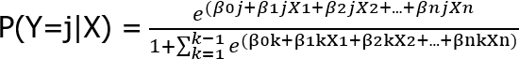
MULTINOMIAL LOGISTIC REGRESSION WITH L2 (RIDGE) REGULARIZATION
It is a statistical method used to predict outcomes with more than two categories of a dependent variable, based on one or more independent variables.
Why Use Multinomial Logistic Regression?
Used when the dependent variable is categorical with more than two classes.
The model compares each category of the dependent variable to a reference (base) category.
It estimates the probability that an observation belongs to each category.

Slide 26
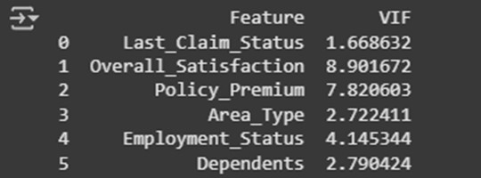
To check Multicollinearity :
Model Performance Summary
Metric
Score
Accuracy
64.81%
AUC Score
0.81
Since, all the VIF’s are less than 10, we can conclude that there is no multicollinearity present between the independent variables.
Accuracy: 64.81% – The model correctly classifies 64.81% of the test data.
AUC Score: 0.81 – The model has strong discriminatory power, meaning it effectively distinguishes between different classes of "Switch_To_Government."

Slide 27
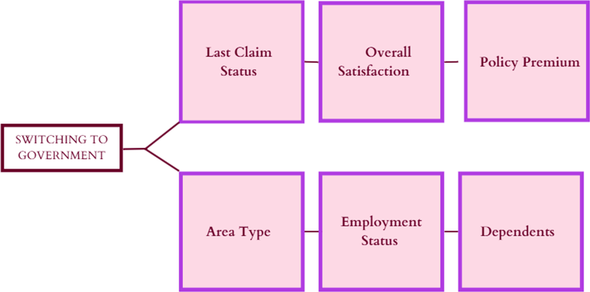
To assess the impact of various factors last claim status, overall satisfaction, policy premium, area type, employment status, and dependents on the likelihood of switching from private to government health insurance.
OBJECTIVE 6
Hypothesis:
H₀: No relationship between predictors and switching decision H₁: At least one factor significantly affects switching behavior
VARIABLE IDENTIFICATION

Slide 28
Wald’s Test
Feature
Last Claim Status Overall Satisfaction Policy Premium Area Type Dependents Employment Status
p-value
0.0005
0.0001
0.027
0.134
0.008
0.095
Significance
Significant Highly Significant
Significant Not Significant
Significant Not Significant
INTERPRETATION:
Customer satisfaction has the strongest impact on switching decisions. Higher premiums increase the likelihood of switching to government plans. Claim experience (Last Claim Status) strongly affects retention.
Area Type & Employment Status are not significant predictors.

Slide 29
REFERENCES
Research Papers & Articles
https://www.cureusjournals.com/articles/3010-predictive-precision-unraveling-health-insurance- claim-patterns-with-logistic-regression-and-decision-trees?utm_source=chatgpt.com#!/
https://www.researchgate.net/publication/369436192_Prediction_for_Insurance_Premiums_Based_on_R andom_Forest_and_Multiple_Linear_Regression/download
Industry Reports & Websites:
Insurance Industry Performance in India ResearchGate Link Health Insurance Trends Forbes Advisor
Statistical Techniques in Insurance Analytics Emerald Insight Random Forests and Decision Trees in Risk Estimation ResearchGate
Fuzzy Clustering Algorithms for Insurance Data Segmentation ResearchGate Multivariate Statistical Analysis Applied Multivariate Statistics – Johnson & Wichern K-Nearest Neighbors Algorithm GeeksForGeeks

Slide 30


